Slide 1
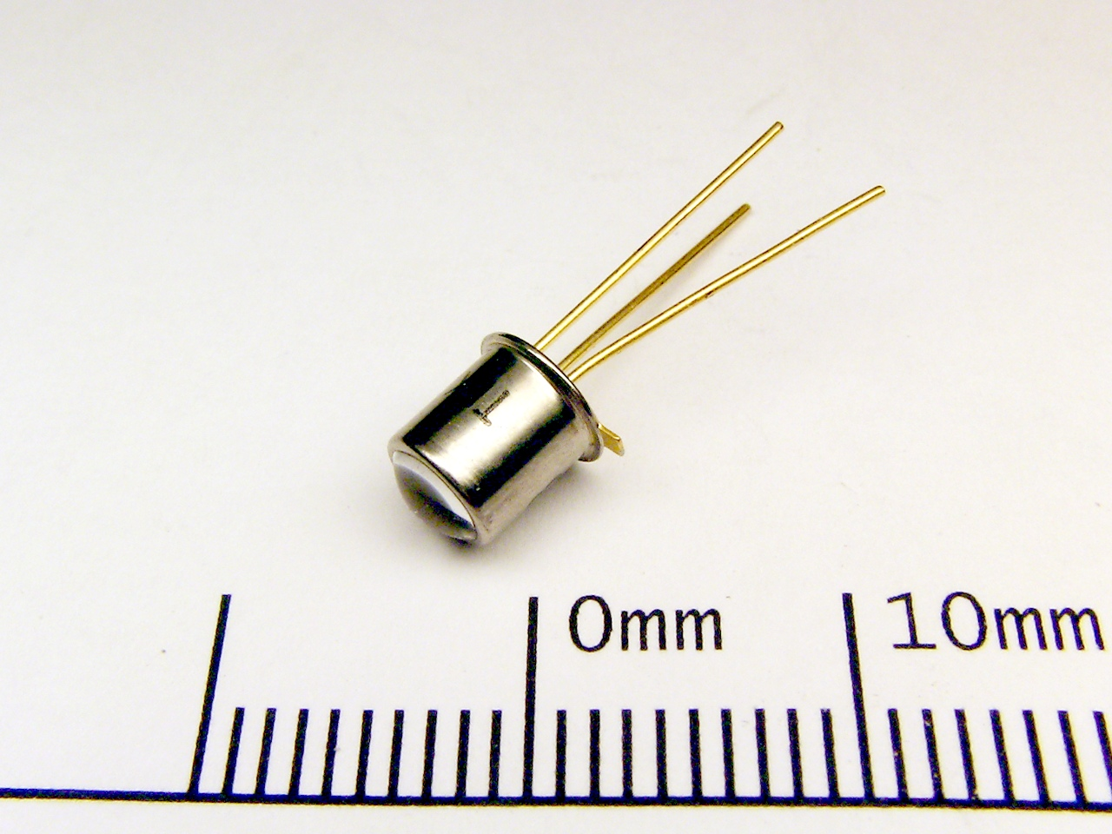
PHOTO TRANSISTOR
Dr.A.ANBARASI
ASSOCIATE PROFESSOR
DEPARTMENT OF PHYSICS
CUDDALORE

Slide 2
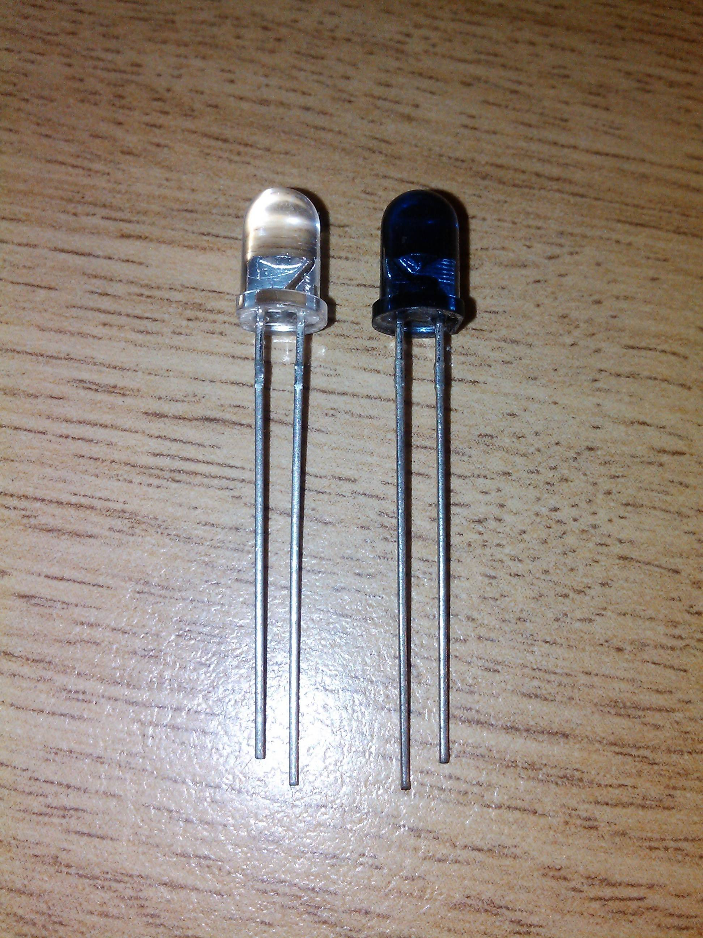
This Photo by Unknown Author is licensed under CC BY-SA

Slide 3
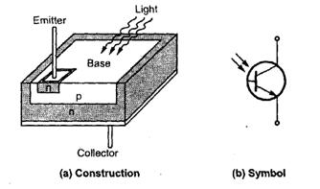
PHOTO TRANSISTOR

Slide 4
PHOTO TRANSISTOR
The phototransistor effectively converts light energy to an electrical signal. In a phototransistor the base current is produced when light strikes the photosensitive semiconductor base region. The collector-base pn junction is exposed to incident light through a lens opening in the transistor package.

Slide 5
WORKING OF PHOTO TRANSISTOR
A photo transistor depends on the intensity of radiation falling at its base region.
Its working is almost similar to a normal transistor, however; the variation lies in the input current that drives the circuit. And in the case of a phototransistor, the incident light generates driving current.
The figure below represents the biasing arrangement of a phototransistor

Slide 6
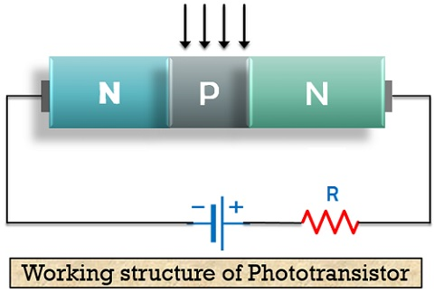
WORKING OF PHOTO TRANSISTOR

Slide 7
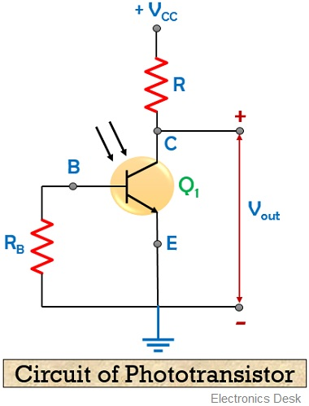
CIRCUIT OF PHOTO TRANSISTOR

Slide 8
PHOTO CURRENT
As the intensity of the light falling at the base region is increased, the current through the device also increases. Here, the generated photocurrent majorly depends on the illumination provided to the base.

Slide 9
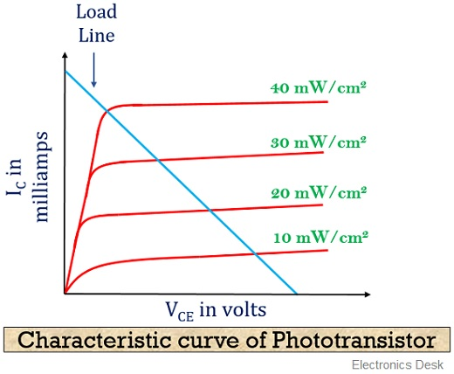
CHARACTERISTIC CURVE OF PHOTO TRANSISTOR

Slide 10
CHARACTERISTICS
Here x-axis represents the voltage applied at the collector-emitter terminal of the transistor and y-axis represents the collector current that flows through the device in mill amperes.
As all the curves in the above figure are clearly indicating that current increases with the intensity of the radiation that falls at the base region.

Slide 11
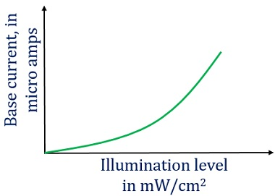
BASE CURRENT vsILLUMUNATION LEVEL

Slide 12
ADVANTAGES & DISADVANTAGES
Advantages of Phototransistor
These are a highly sensitive optoelectronic device.
It is less complex and inexpensive.
Phototransistors provides a large output current with high gain.
Disadvantages of Phototransistor
It provides a low-frequency response.
In the case when a small amount of illumination is provided, the circuit is not able to detect it effectively.
Electric surges are more severe in phototransistors rather than a photodiode.
Phototransistors gets affected by the variation in electromagnetic energy.

Slide 13
APPLICATIONS OF PHOTO TRANSISTOR
In light controlling and detection: As phototransistors are a very sensitive light detector. Thus these are widely used in light detection and controlling applications.
In an indication of level and relays: The device finds its uses in indicating the level of some systems because of their light sensing ability.
In counting systems: Phototransistors can be effectively utilized in counting systems. As it has tremendous ability to combinely operate as photodiode and transistors. Thus, failure of supply will not cause much adverse effects on the system.
In punch card readers: Phototransistors widely finds its applications in punch card reading.

Slide 14


